Slide 1
Medium-Sized Switched Network Construction
Troubleshooting Switched Networks

Slide 2
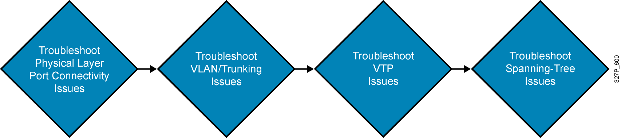
Switches Troubleshooting
General troubleshooting suggestions:
  Become familiar with normal switch operation.
  Have an accurate physical and logical map of the network.
  Have a plan.
  Do not assume a component is working without verifying it first.

Slide 3
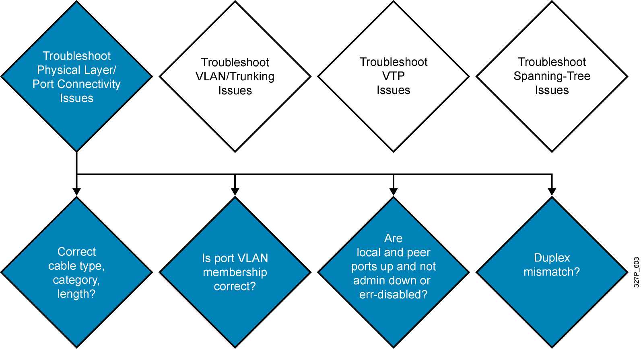
Troubleshooting Port Connectivity

Slide 4
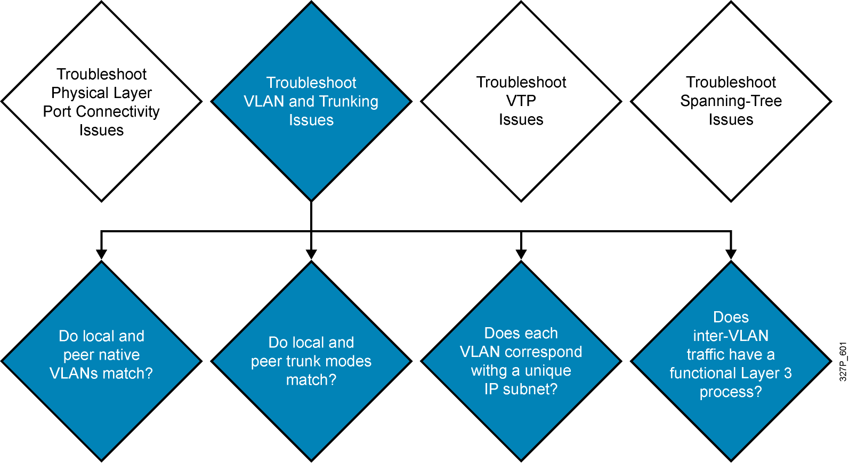
Troubleshooting VLANs and Trunks

Slide 5
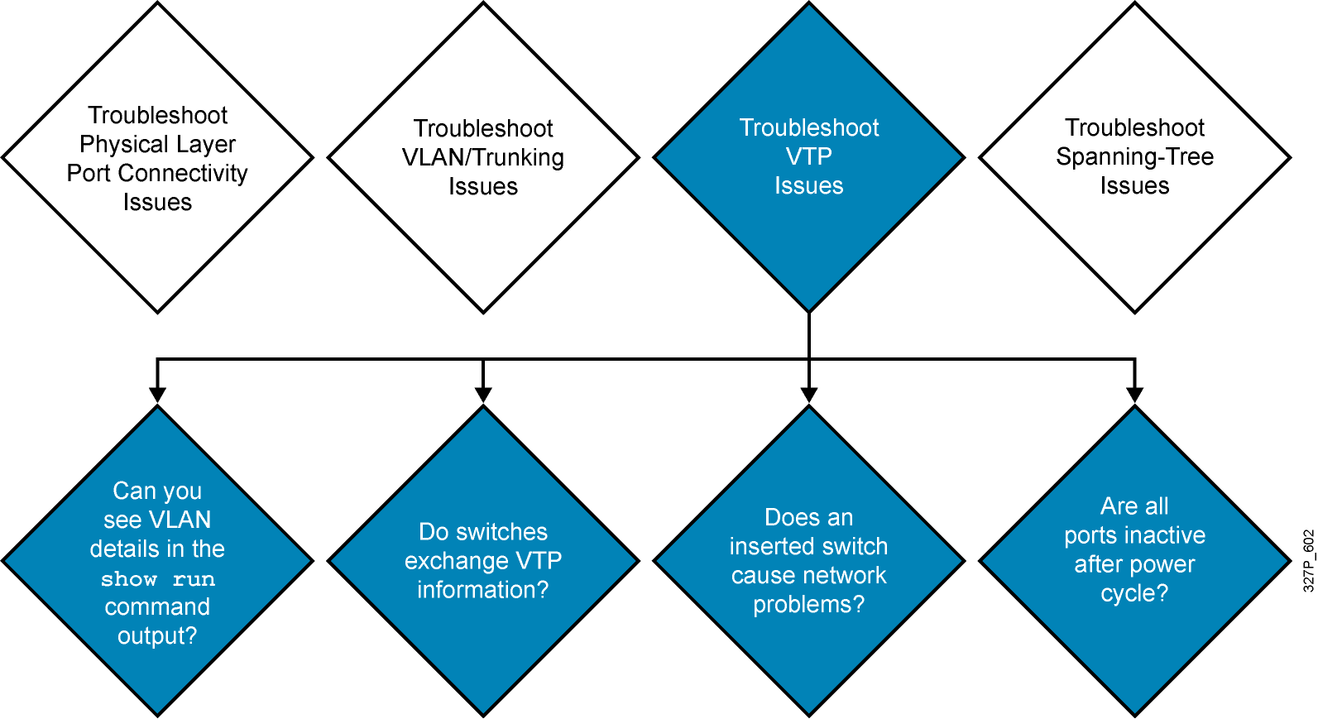
Troubleshooting VTP

Slide 6
Troubleshooting VTP (Cont.)
Verify these settings if Catalyst switches do not exchange
VTP information :
  All ports that interconnect switches are configured as trunks.
  VLANs are active in all server switches.
  There is at least one VTP server switch.
  The VTP domain name, and password, if assigned, match on all switches (case-sensitive).
  The switches all run the same version of VTP.
  Verify the domain name and VTP version on transparent switches.
  Be aware that extended-range VLANs do not propagate for VTPv1 and VTPv2.

Slide 7
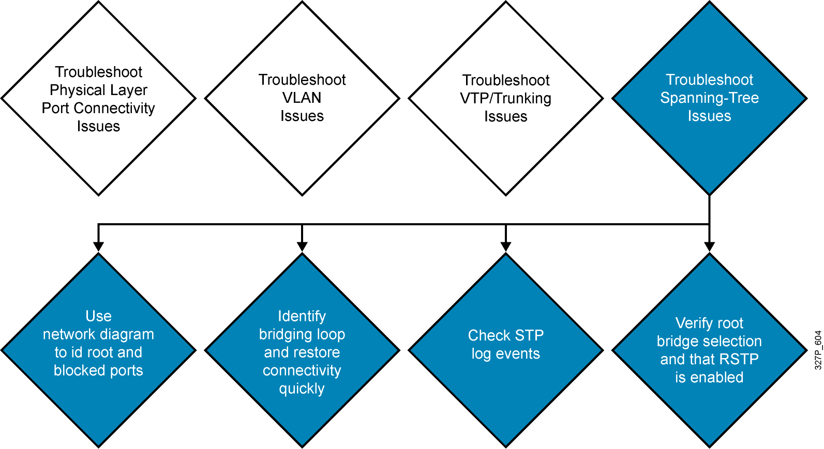
Troubleshooting Spanning Tree

Slide 8
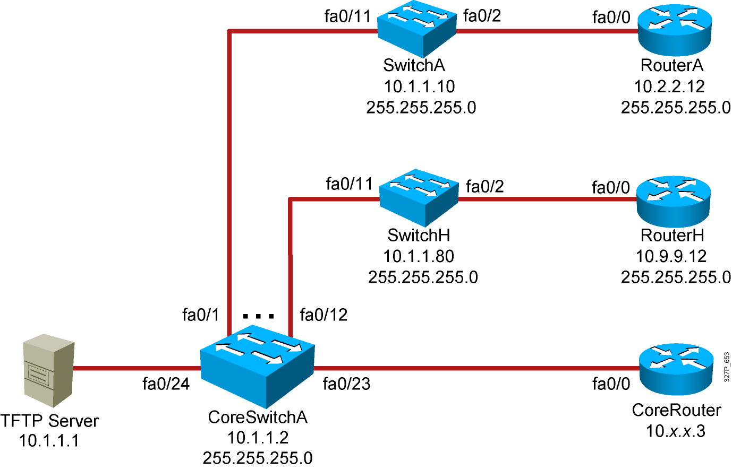
Visual Objective 2-2:
Troubleshooting Switched Networks
WG Switch Router
fa0/0
A 10.1.1.10 10.2.2.12
B 10.1.1.20 10.3.3.12
C 10.1.1.30 10.4.4.12
D 10.1.1.40 10.5.5.12
E 10.1.1.50 10.6.6.12
F 10.1.1.60 10.7.7.12
G 10.1.1.70 10.8.8.12
H 10.1.1.80 10.9.9.12
Notes:
Lab ?
Missing link core_ro ------core_sw_a. Fixed, kcm.

Slide 9
Summary
  Effective switched-network troubleshooting begins by understanding what makes a network function correctly.
  Hardware issues and port configuration errors can cause port connectivity issues.
  Native VLAN mismatches and trunk mode mismatches can prevent a trunk link from being established.
  Understanding how VTP works is the best defense when troubleshooting VTP problems.
  One of the primary objectives when dealing with an STP failure is to break the loop and restore connectivity as soon as possible.

